Slide 1
CS5542 Big Data Analytics and Applications Tutorial 4A March 1, 2018

Slide 2
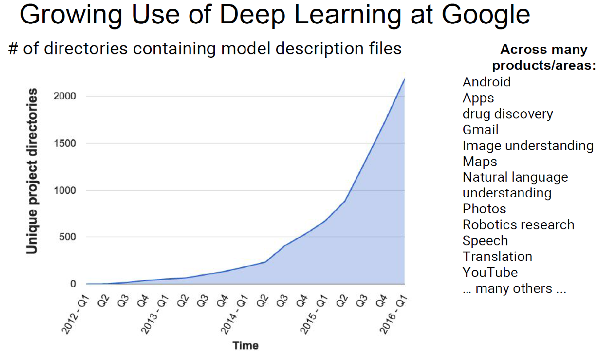

Slide 3
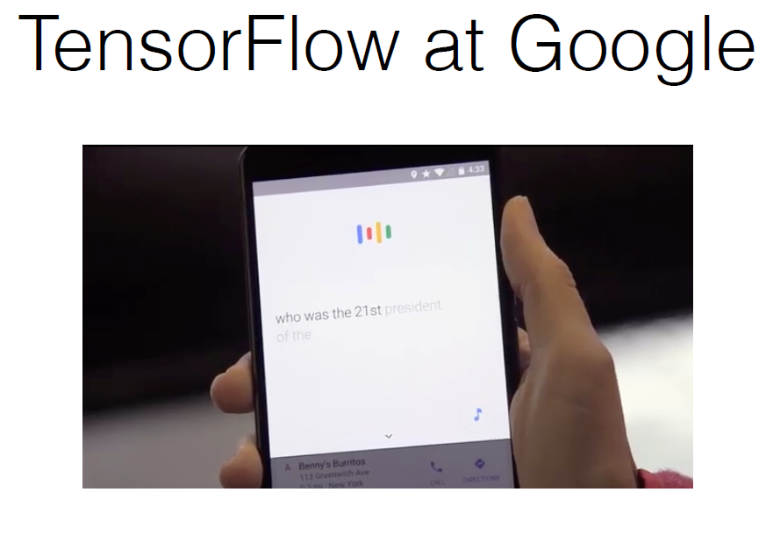

Slide 4


Slide 5
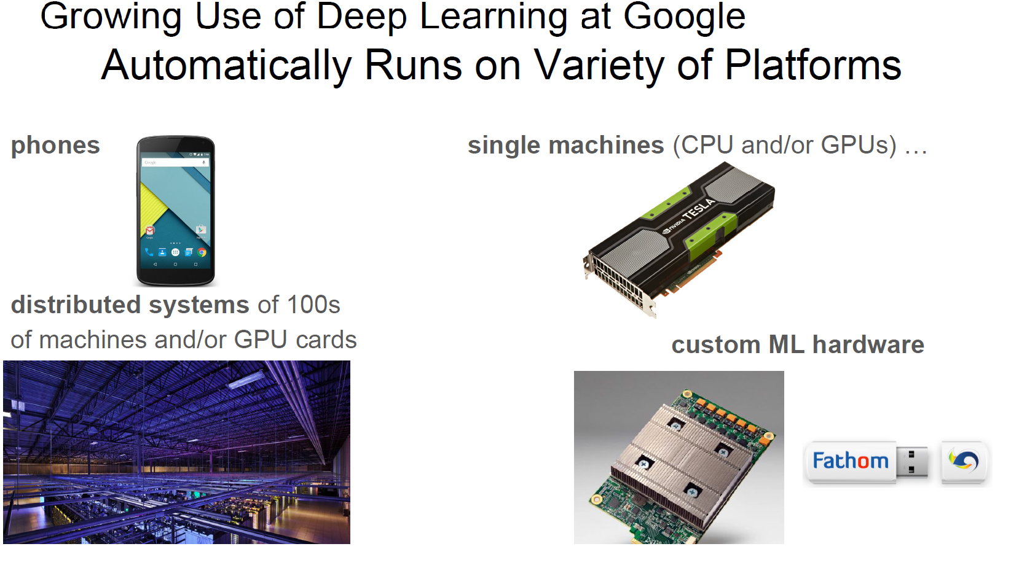

Slide 6
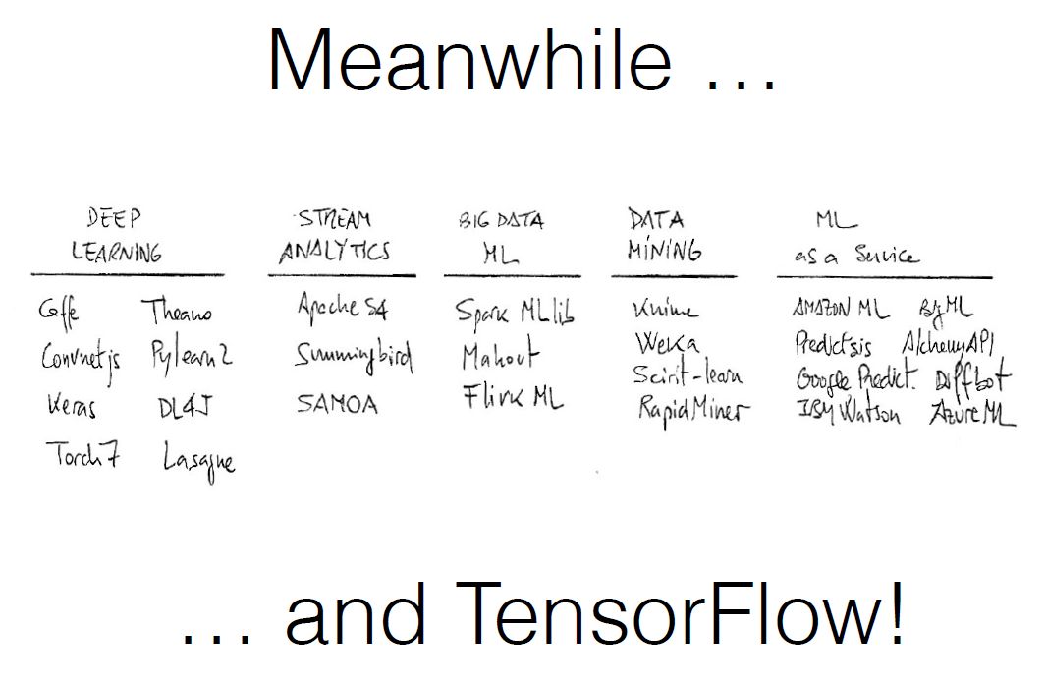
-*

Slide 7
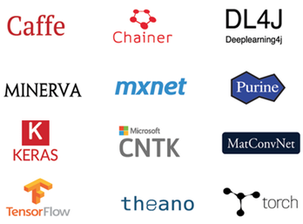
Deep learning frameworks
Many deep learning frameworks are made open source by companies and universities:
Caffe
TensorFlow
Computational Network Toolkit (CNTK)
Theano
Torch
Mxnet
Deeplearning4j
Deep learning systems are designed for scalability:
DistBelief
SparkNet
https://developer.nvidia.com/deep-learning-getting-started

Slide 8
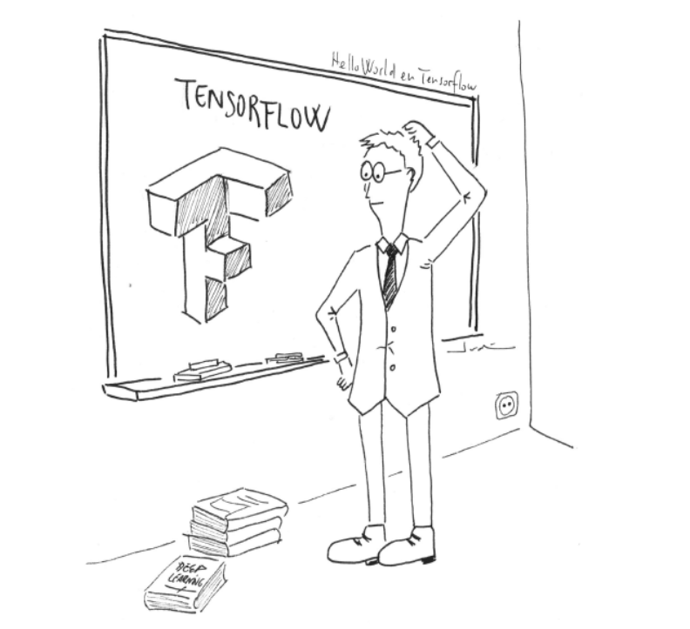

Slide 9
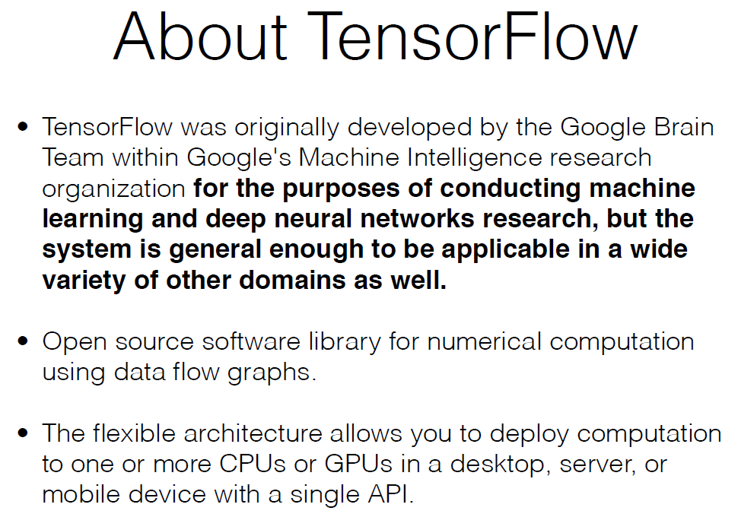

Slide 10
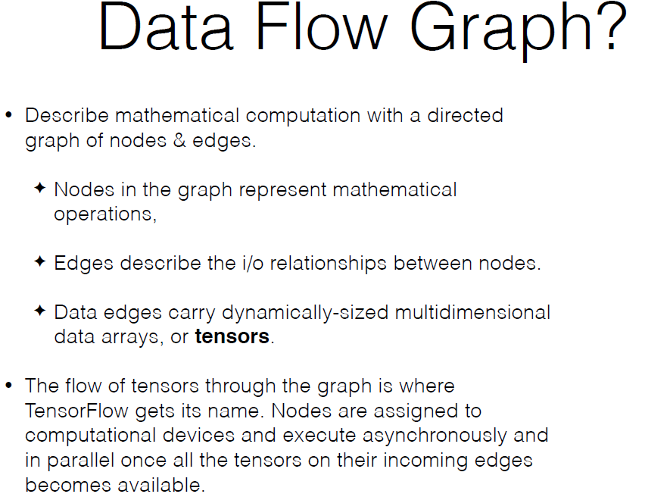

Notes:
Dean, Jeffrey, Abadi, Martın, et al. "Tensorflow: Large-scale machine learning on heterogeneous distributed systems." arXiv preprint arXiv:1603.04467 (2016).
https://www.tensorflow.org/

Slide 11
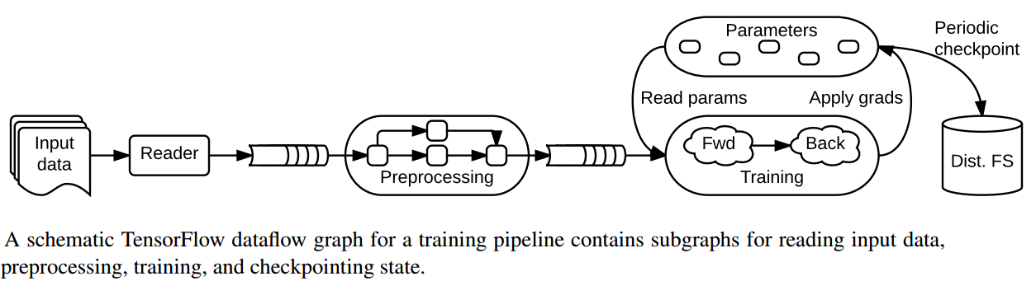

Slide 12
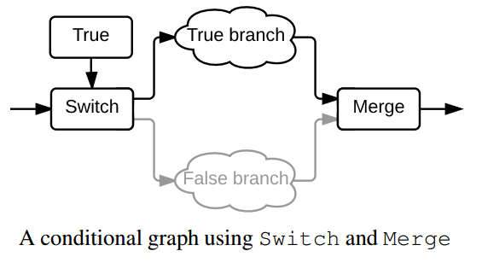
Dynamic Control Flow

Slide 13
Computation Graph
TensorFlow programs are usually structured into a construction phase, that assembles a graph, and an execution phase that uses a session to execute ops in the graph
We program to assemble the graph
The TensorFlow Python library has a default graph to which ops constructors add nodes
The TensorFlow Python library has a default graph to which ops constructors add nodes
TensorFlow relies on a highly efficient C++ backend to do its computation. The connection to this backend is called a session.
InteractiveSession is to interleave operations
We can also enter a session with a “with” block. The session ends automatically

Slide 14
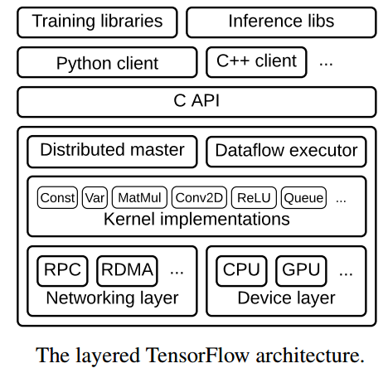

Slide 15
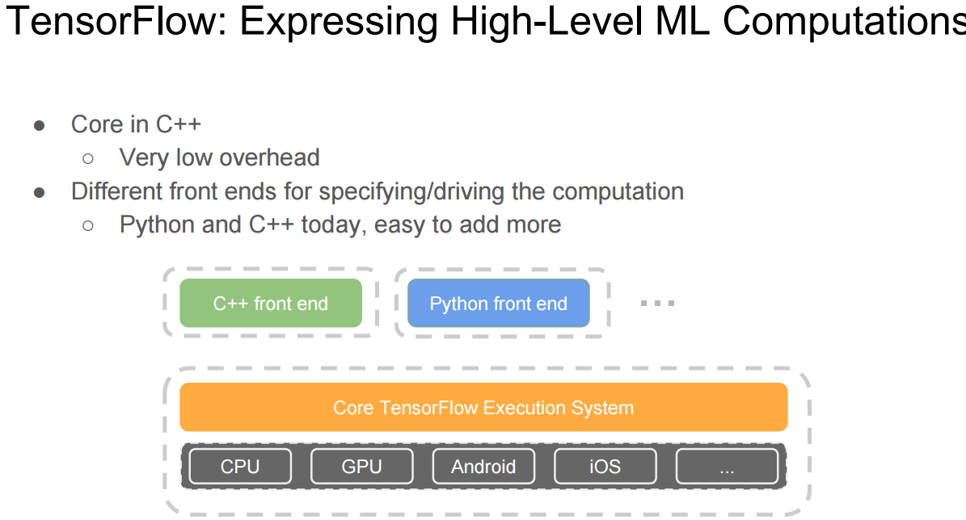

Slide 16
Math operations for manipulate the tensors
Operation | Description
tf.add | sum
tf.sub | substraction
tf.mul | multiplication
tf.div | division
tf.mod | module
tf.abs | return the absolute value
tf.neg | return negative value

Slide 17
Math operations for manipulate the tensors
tf.sign | return the sign
tf.inv | returns the inverse
tf.square | calculates the square
tf.round | returns the nearest integer
tf.sqrt | calculates the square root
tf.pow | calculates the power
tf.exp | calculates the exponential
tf.log | calculates the logarithm
tf.maximum | returns the maximum
tf.minimum | returns the minimum
tf.cos | calculates the cosine
tf.sin | calculates the sine

Slide 18
Math operations (cont)
Operation | Description
tf.diag | returns a diagonal tensor with a given diagonal values
tf.transpose | returns the transposes of the argument
tf.matmul | returns a tensor product of multiplying two tensors listed as arguments
tf.matrix_determinant | returns the determinant of the square matrix speciﬁed as an argument
tf.matrix_inverse | returns the inverse of the square matrix speciﬁed as an argument

Slide 19
Operations & Kernels
•
An operation has a name and represents an abstract computation (e.g., “matrix multiply”, or “add”). An operation can have attributes
•
A kernel is a particular implementation of an operation that can be run on a particular type of device (e.g., CPU or GPU).
•
A TensorFlow binary defines the sets of operations and kernels available

Slide 20
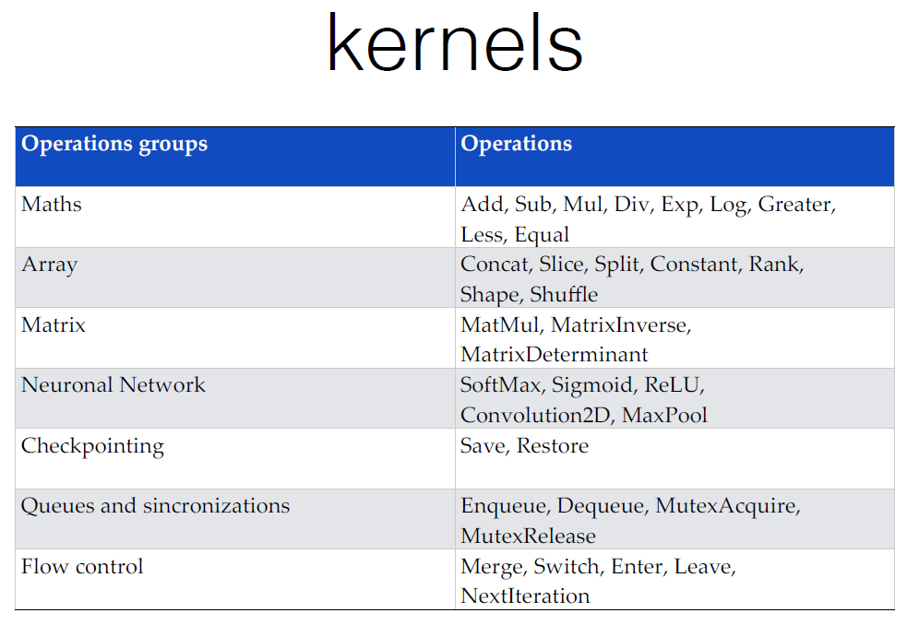
device-specific implementations of operations

Slide 21
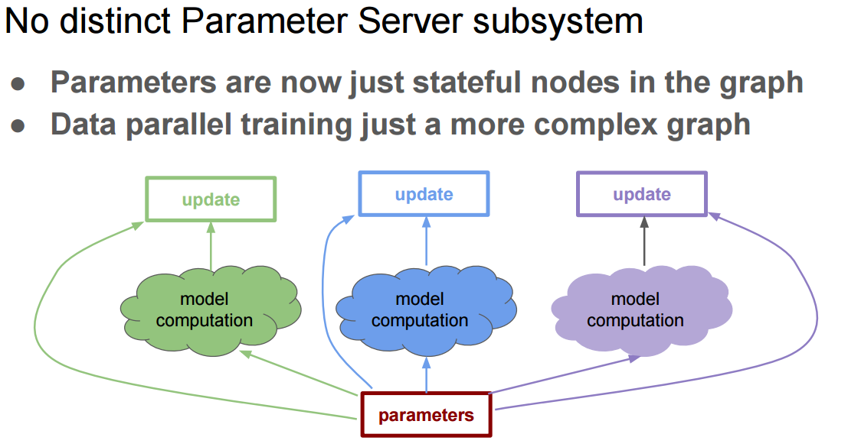

Slide 22
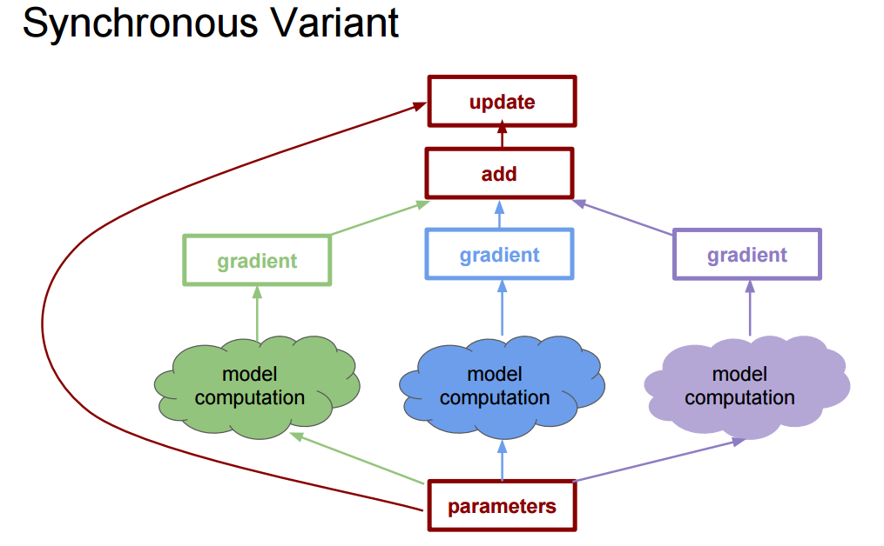

Slide 23
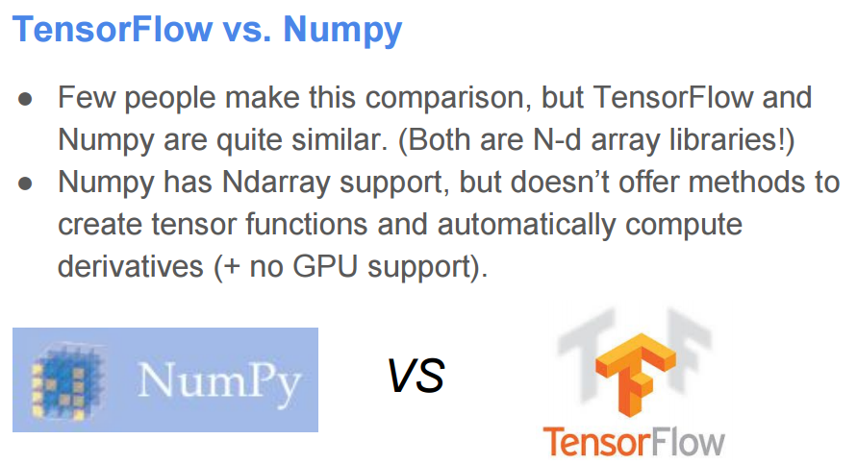

Slide 24
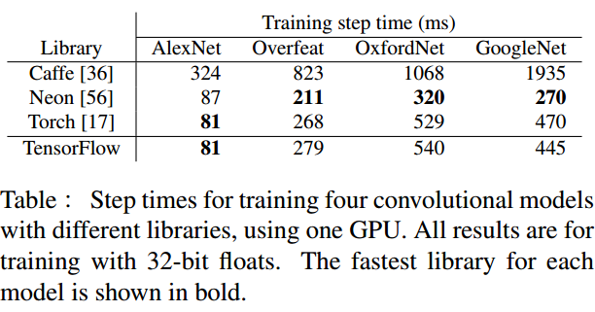

Slide 25
Analysis of speed comparison results
This speed comparison is provided by Microsoft, the benchmarking is done using NVIDIA K40 GPUs. It doesn’t reflect complete capabilities of TensorFlow.
As of December 2015, Microsoft CNTK supports cuDNN v4, but TensorFlow only supports cuDNN v2. This might have resulted in higher speeds for CNTK.
Also, Google hasn’t open sourced distributed version of TensorFlow until February 2016. So, speed comparison for multi-machine implementation is missing.
TensorFlow have recently evolved into a robust deep learning framework with a focus on speed, flexibility (covers wide range of fields than CNTK) and portability (supports mobile).
https://www.microsoft.com/en-us/research/microsoft-computational-network-toolkit-offers-most-efficient-distributed-deep-learning-computational-performance/

Slide 26
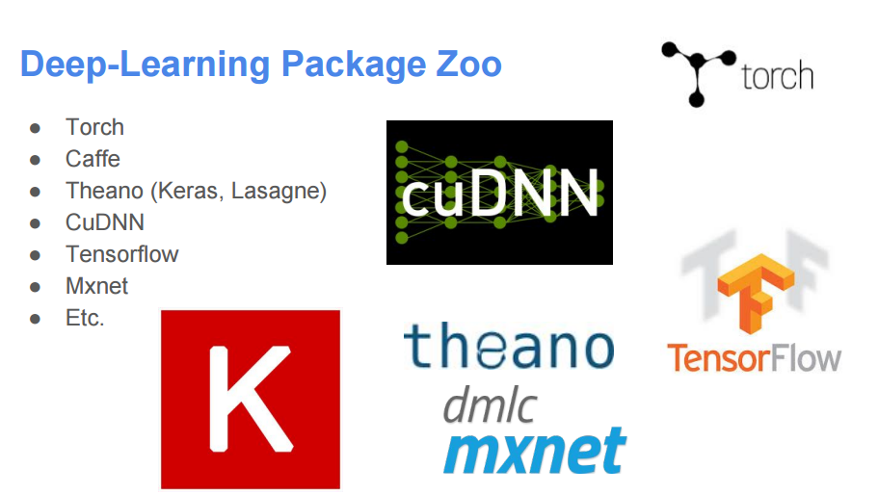
Notes:
http://deeplearning4j.org/compare-dl4j-torch7-pylearn.html
https://github.com/zer0n/deepframeworks

Slide 27
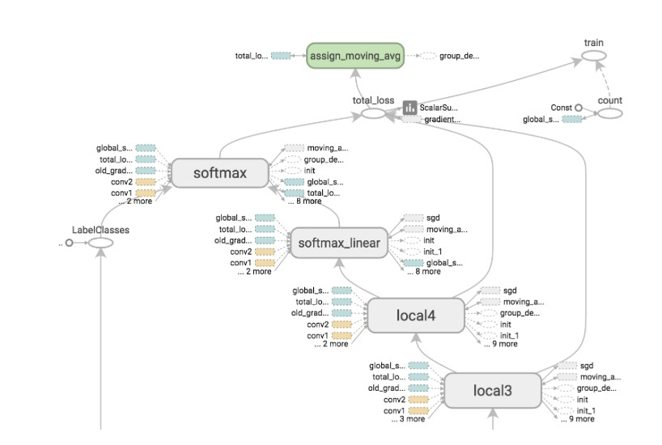
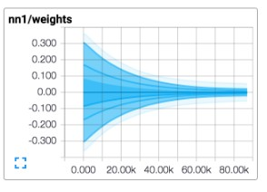
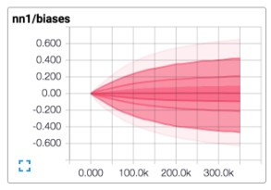
TensorBoard: Visualization of graph structures and summary statistics
TensorFlow included functions to debug and optimize programs in a visualization tool called TensorBoard.
Helps users understand the structure of their computation graphs and also to understand the overall behavior of machine learning models.
The data displayed with TensorBoard module are generated during the execution of TensorFlow and stored in trace files whose data are obtained from the summary operations
http://localhost:6006/

Slide 28
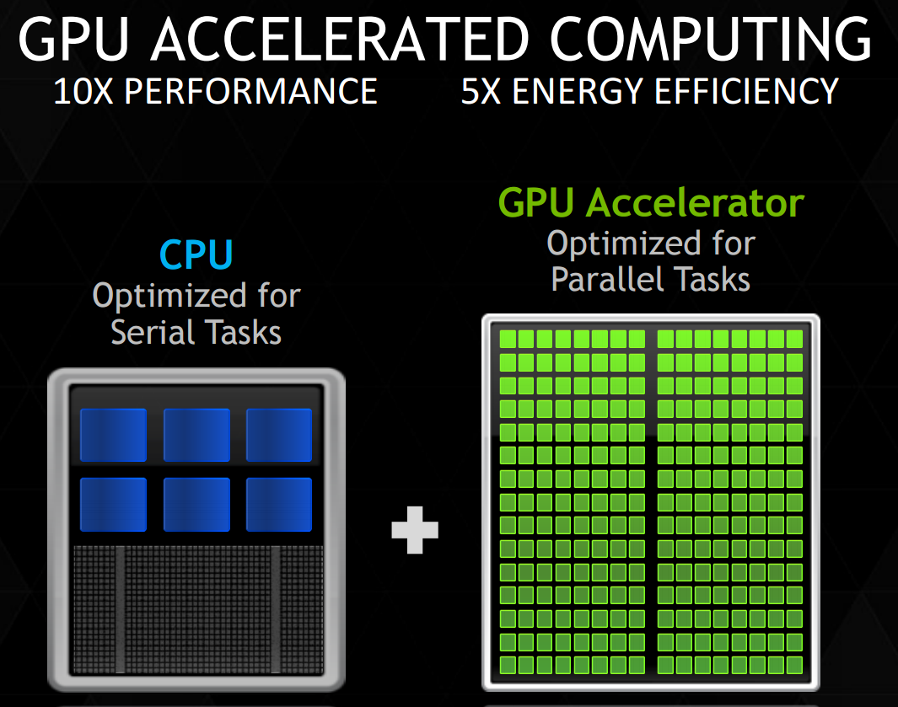
Choice of CPU vs GPU
The parallel architecture in a GPU is suitable for vector and matrix operations.
GPU acceleration for graph analytics : 1 GPU vs 60 nodes:-
280x vs optimized Spark
1440x vs Spark
3420x vs Hadoop
Notes:
http://www.nvidia.com/content/events/geoInt2015/LBrown_DL.pdf

Slide 29
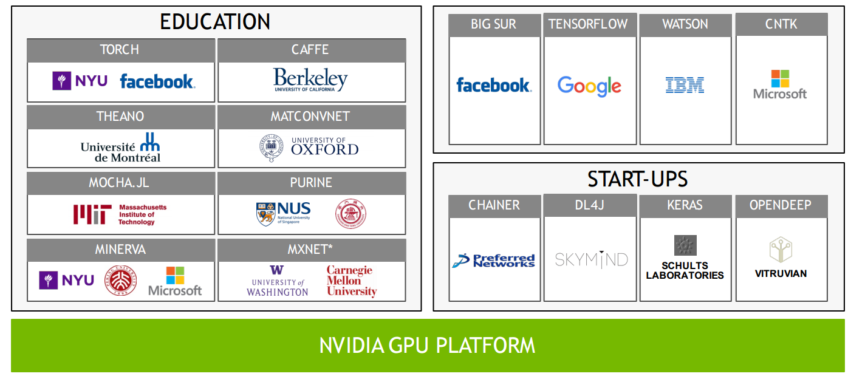
NVIDIA Deep Learning SDK
Provides powerful tools and libraries for designing and deploying GPU-accelerated deep learning applications. It consists of many tools and libraries like cuDNN, GIE, CUDA toolkit etc.,
cuDNN provides highly tuned implementations for standard routines such as forward and backward convolution, pooling, normalization, and activation layers.
GPU Inference Engine (GIE) optimizes your trained neural networks for runtime performance.
Deep Learning GPU Training System (DIGITS) helps in designing the best deep neural network (DNN) for image classification and object detection tasks using real-time network behavior visualization.
Notes:
http://on-demand.gputechconf.com/gtc/2015/webinar/deep-learning-course/intro-to-deep-learning.pdf

Slide 30
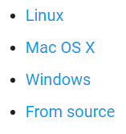
Installation
Available in:
And python 2 and 3.
For this class we will use python3 and Ubuntu.

Slide 31
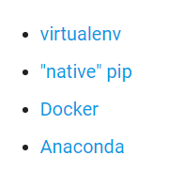
Types of Installation
CPU only and GPU enabled
Choices:
For this class prefer using virtualenv or anaconda

Slide 32
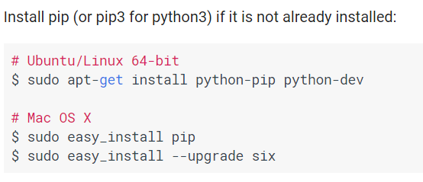
Installation(python3 for class)
Pip Installation
Make python3 default: alias python=python3
Notes:
# Ubuntu/Linux 64-bit, CPU only, Python 2.7
$ export TF_BINARY_URL=https://storage.googleapis.com/tensorflow/linux/cpu/tensorflow-1.0.0-cp27-none-linux_x86_64.whl
# Ubuntu/Linux 64-bit, GPU enabled, Python 2.7
# Requires CUDA toolkit 8.0 and CuDNN v5. For other versions, see "Installing from sources" below.
https://storage.googleapis.com/tensorflow/linux/gpu/tensorflow_gpu-1.0.0-cp27-none-linux_x86_64.whl
# Mac OS X, CPU only, Python 2.7:
$ export TF_BINARY_URL=https://storage.googleapis.com/tensorflow/mac/cpu/tensorflow-1.0.0-py2-none-any.whl
# Mac OS X, GPU enabled, Python 2.7:
$ export TF_BINARY_URL=https://storage.googleapis.com/tensorflow/mac/gpu/tensorflow_gpu-1.0.0-py2-none-any.whl
# Ubuntu/Linux 64-bit, CPU only, Python 3.4
$ export TF_BINARY_URL=https://storage.googleapis.com/tensorflow/linux/cpu/tensorflow-1.0.0-cp34-cp34m-linux_x86_64.whl
# Ubuntu/Linux 64-bit, GPU enabled, Python 3.4
# Requires CUDA toolkit 8.0 and CuDNN v5. For other versions, see "Installing from sources" below.
$ export TF_BINARY_URL=https://storage.googleapis.com/tensorflow/linux/gpu/tensorflow_gpu-1.0.0-cp34-cp34m-linux_x86_64.whl
# Ubuntu/Linux 64-bit, CPU only, Python 3.5
$ export TF_BINARY_URL=https://storage.googleapis.com/tensorflow/linux/cpu/tensorflow-1.0.0-cp35-cp35m-linux_x86_64.whl
# Ubuntu/Linux 64-bit, GPU enabled, Python 3.5
# Requires CUDA toolkit 8.0 and CuDNN v5. For other versions, see "Installing from sources" below.
$ export TF_BINARY_URL=https://storage.googleapis.com/tensorflow/linux/gpu/tensorflow_gpu-1.0.0-cp35-cp35m-linux_x86_64.whl
# Mac OS X, CPU only, Python 3.4 or 3.5:
$ export TF_BINARY_URL=https://storage.googleapis.com/tensorflow/mac/cpu/tensorflow-1.0.0-py3-none-any.whl
# Mac OS X, GPU enabled, Python 3.4 or 3.5:
$ export TF_BINARY_URL=https://storage.googleapis.com/tensorflow/mac/gpu/tensorflow_gpu-1.0.0-py3-none-any.whl

Slide 33
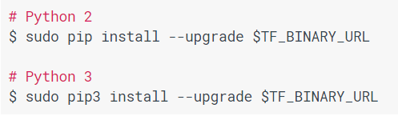
Installation(python3 for class)
# Ubuntu/Linux 64-bit, CPU only, Python 2.7
$ export https://storage.googleapis.com/tensorflow/linux/cpu/tensorflow-1.0.0-cp27-none-linux_x86_64.whl

Slide 34
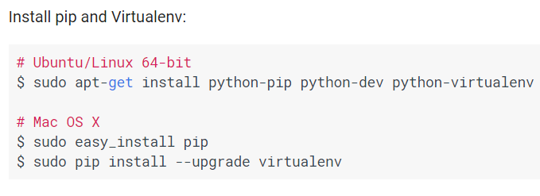
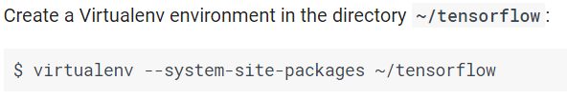
Installation(python3 for class)
Virtualenv installation
Next steps are same as previous

Slide 35
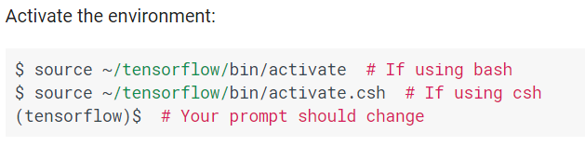
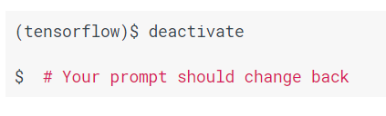

Slide 36
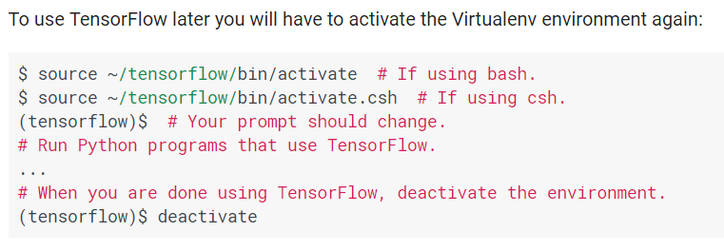
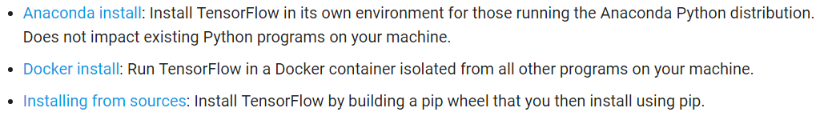
Installation

Slide 37
Installation(Windows)
Not preferred for class
Anaconda mechanism is best for windows
Tensorflow only works for 64 bit and python3.5.X
Install Anaconda 64 bit https://www.continuum.io/downloads
Make anaconda's python as default in system.(change system path)
downgrade python to 3.5 version: conda install python=3.5

Slide 38
Installation(Windows)
C:> conda create -n tensorflow
C:> activate tensorflow
(tensorflow)C:> # Your prompt should change
(tensorflow) C:\Users\Manikanta>pip install --ignore-installed --upgrade https://storage.googleapis.com/tensorflow/windows/cpu/tensorflow-1.0.0-cp35-cp35m-win_x86_64.whl
or
https://storage.googleapis.com/tensorflow/windows/cpu/tensorflow-1.0.0-cp35-cp35m-win_amd64.whl

Slide 39
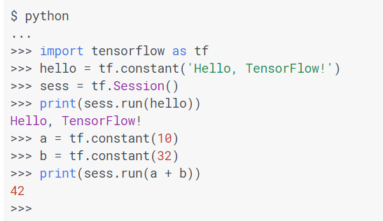
Test Installation

Slide 40

Sample code
import tensorflow as tf
a = tf.placeholder("float") b = tf.placeholder("float")
y = tf.mul(a, b) sess = tf.Session()
print sess.run(y, feed_dict={a: 4, b: 5})

Slide 41
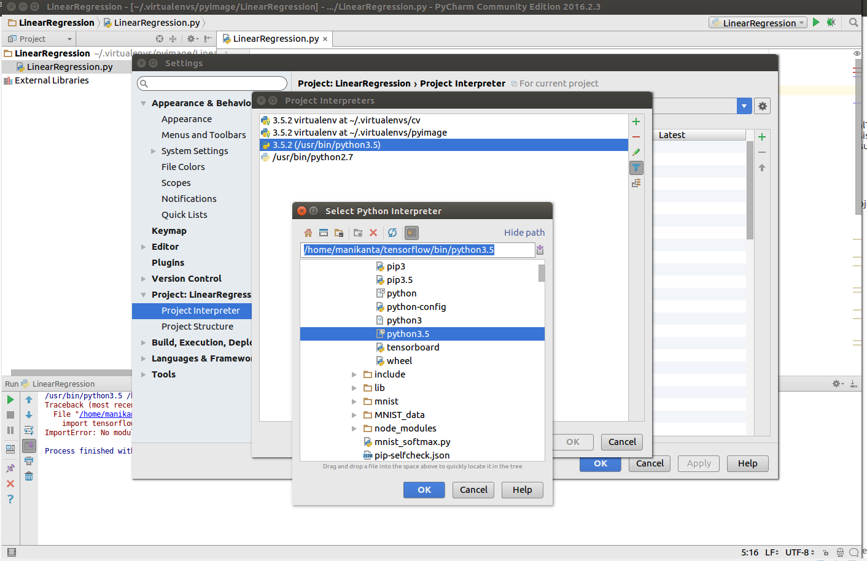
PyCharm Configuration
File -> Setting -> Project -> Project Interpreter
Assign the python lib which ever tensorflow is using

Slide 42
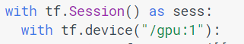
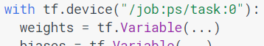
Session
CPU or GPU
Launching the graph in a distributed graph
We can use "with tf.device():" statements to directly specify workers for particular parts of the graph:

Slide 43
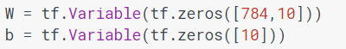
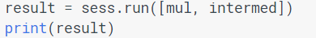
Variables, fetches
Variables maintain state across executions of the graph. It lives in the computation graph
Before Variables can be used within a session, they must be initialized using that session
To fetch the outputs of operations, execute the graph with a run() call on the session object and pass in tensors to retrieve
All the ops needed to produce the values of the requested tensors are run once (not once per requested tensor)

Slide 44
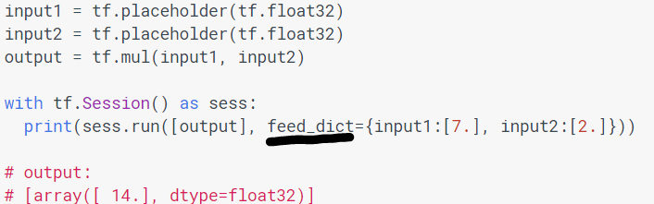
Feeds
feed mechanism for patching a tensor directly into any operation in the graph
A feed temporarily replaces the output of an operation with a tensor value.
Supply feed data as an argument to a run() call

Slide 45
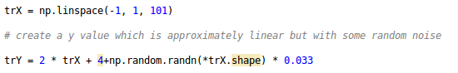
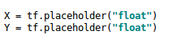
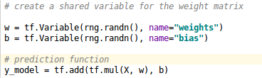
Linear Regression
Random generate training data: for a linear line with some noise.
Create Variables

Slide 46
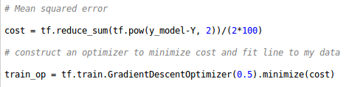
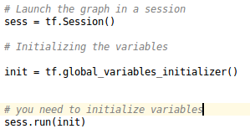
Cost and Optimizer

Slide 47
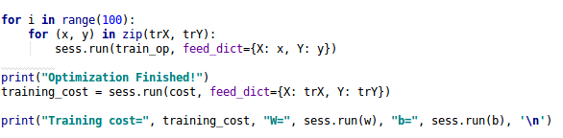
Training
Train through all the training data points
Calculate cost and predict function’s coefficients

Slide 48
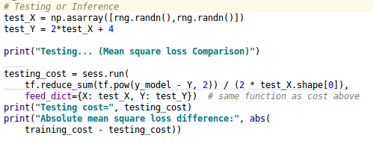
Testing
Calculate absolute mean squared error

Slide 49
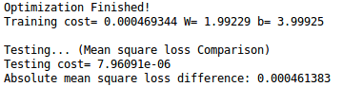
Output
Run python script from command line

Slide 50
References
[1] https://cs224d.stanford.edu/lectures/CS224d-Lecture7.pdf
[2] http://www.slideshare.net/JenAman/large-scale-deep-learning-with-tensorflow
[3] http://www.jorditorres.org/wp-content/uploads/2016/02/FirstContactWithTensorFlow.part1_.pdf
[4] Abadi, Martın, et al. "Tensorflow: Large-scale machine learning on heterogeneous distributed systems." arXiv preprint arXiv:1603.04467 (2016).
[5] Abadi, Martín, et al. "TensorFlow: A system for large-scale machine learning." arXiv preprint arXiv:1605.08695 (2016).
[6] https://www.tensorflow.org/

Slide 51
Thank You !!!

